Slide 1
Capstone Project
Hotel booking analysis
By- TEAM ORCHID (Cohort Canberra)
Saqlain Shaikh
Vivek Saste
Aaquib Hundekari

Slide 2
Content
1. Hotel booking analysis
Knowing the data
Cleaning data
Problem statement
2. Conclusion

Slide 3
Data summary
Data set name – Hotel booking analysis
Shape- 119390 rows x 32 columns
Columns- 'hotel', 'is_canceled', 'lead_time', 'arrival_date_year', 'arrival_date_month', 'arrival_date_week_number', 'arrival_date_day_of_month', 'stays_in_weekend_nights', 'stays_in_week_nights', 'adults', 'children', 'babies', 'meal', 'country', 'market_segment', 'distribution_channel', 'is_repeated_guest', 'previous_cancellations', 'previous_bookings_not_canceled', 'reserved_room_type', 'assigned_room_type', 'booking_changes', 'deposit_type', 'agent', 'company', 'days_in_waiting_list', 'customer_type', 'adr', 'required_car_parking_spaces', 'total_of_special_requests', 'reservation_status', 'reservation_status_date'

Slide 4
Cleaning the data
We have dropped the rows where adults ,babies or children are not present that means they have booked but never stayed.
There are lot of null values in ‘company’ and ‘agent’ so we replaced it with zero.
For the missing values in the country column, we have replaced it with mode (i.e. value that appears most often will added to row where value is missing )

Slide 5
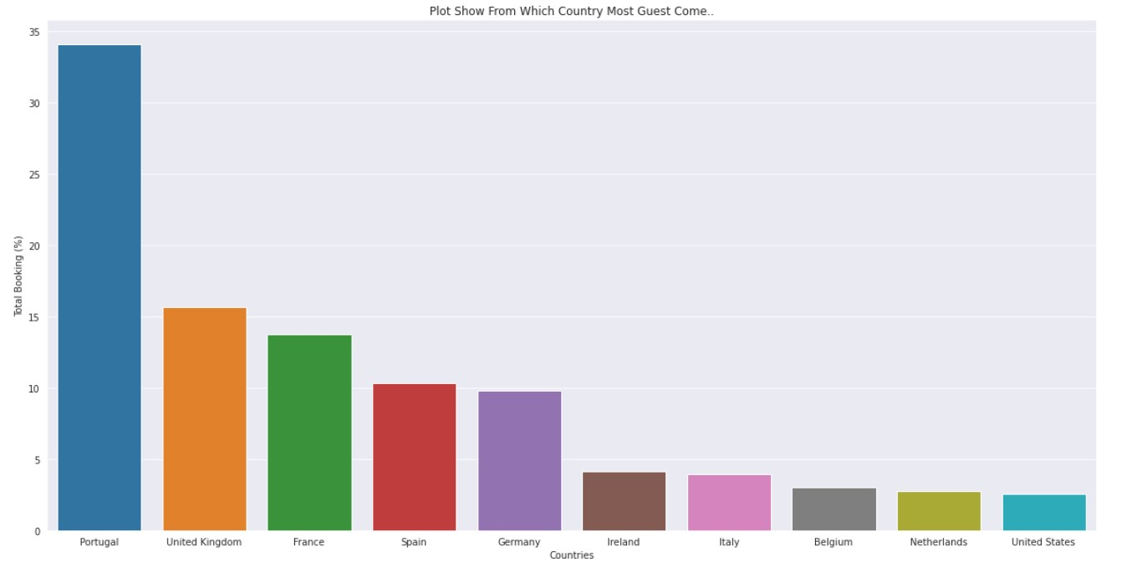
Above plot shows that from which country how many guest has come and we can see that Portugal has higher number of bookings where United states has less no. of booking.

Slide 6
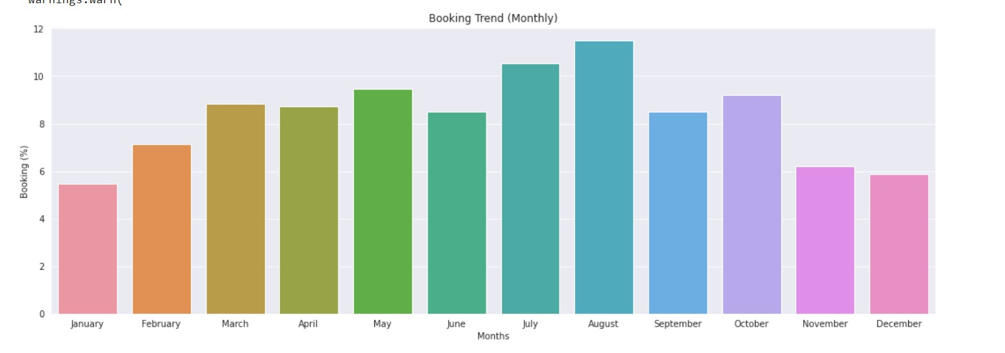
We can see that July and august month has most no. of bookings where January and December. has less no. of bookings compared to July and august

Slide 7
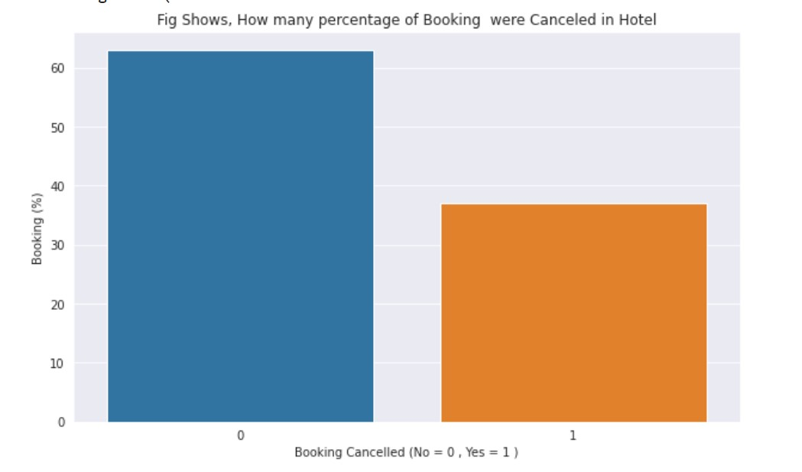
e of
Around 37% booking were canceled in hotel

Slide 8
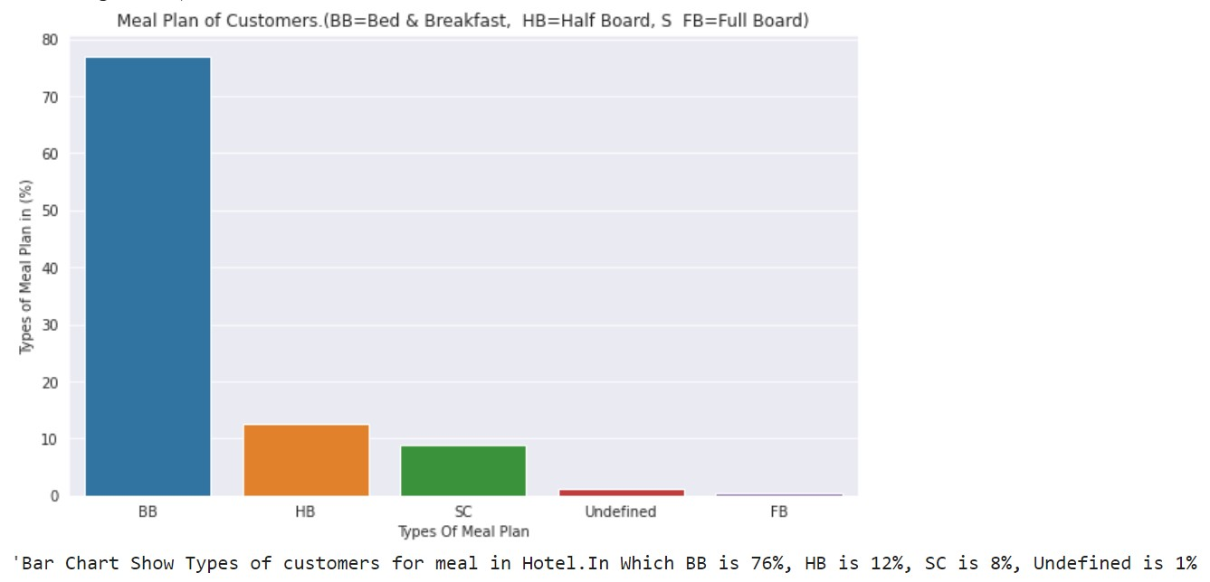
What are the meal plans of customer?
In this bar chart we can see that most customers prefer BB.
And very few select HB &SC

Slide 9
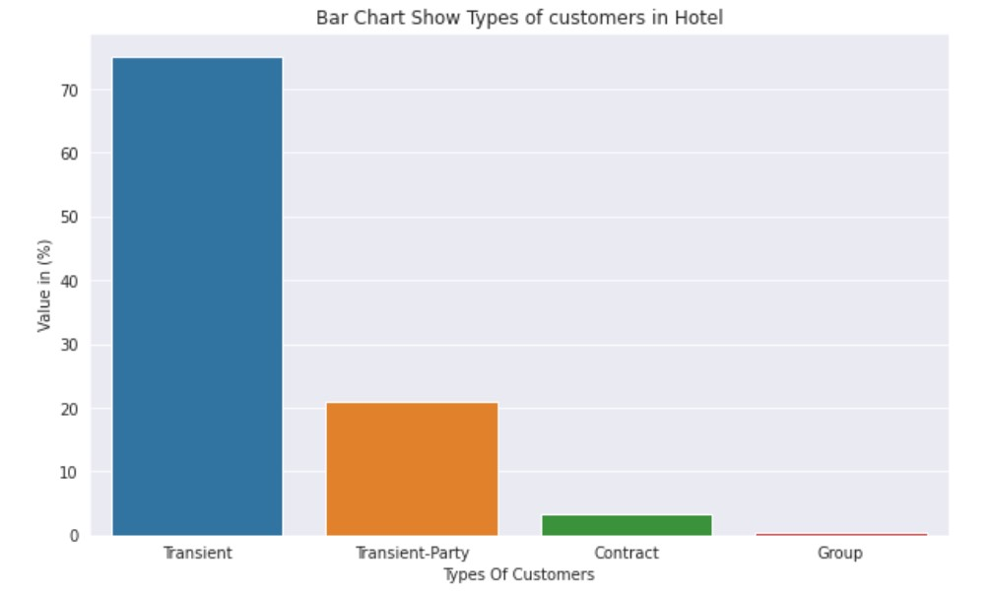
By seeing above graph we can say that transient(a person who is staying/working for short time only) type of customer has more number of bookings. then around 20% transient party,groups have no interest in staying in hotels

Slide 10
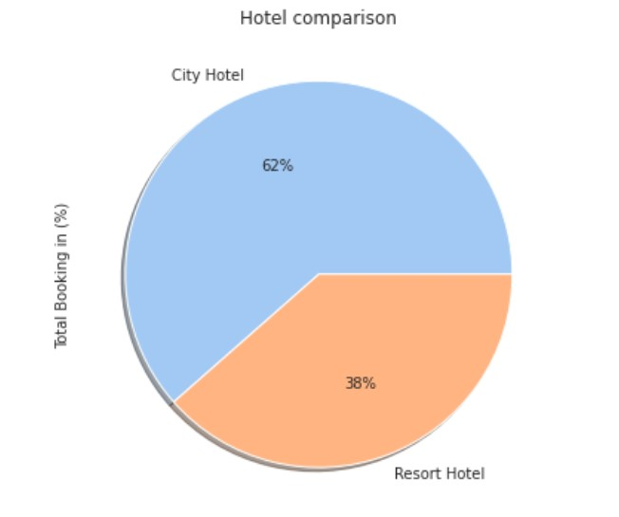
What are the booking ratio of between resort hotel and city hotel?
At pie chart we can see customers focus is more on city hotel i.e 62% customers wants to stay in city hotel and only 38% wants to stay in resorts

Slide 11
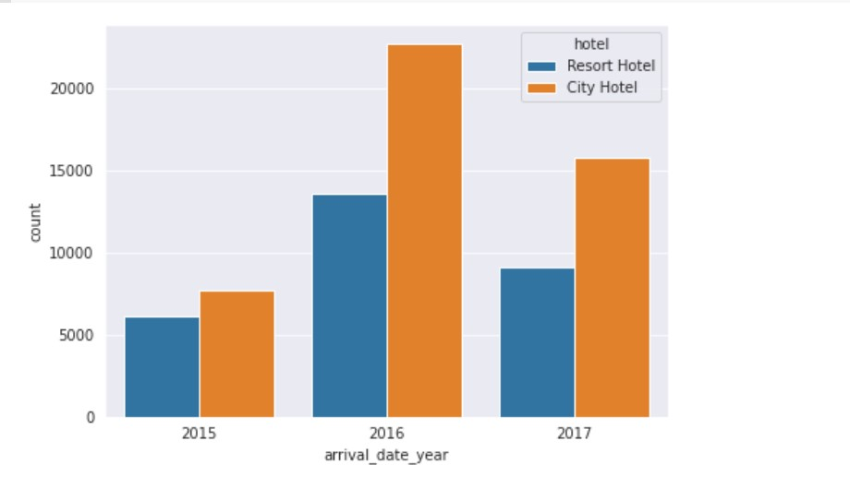
Percentage Booking of each year according to the hotel.

Slide 12
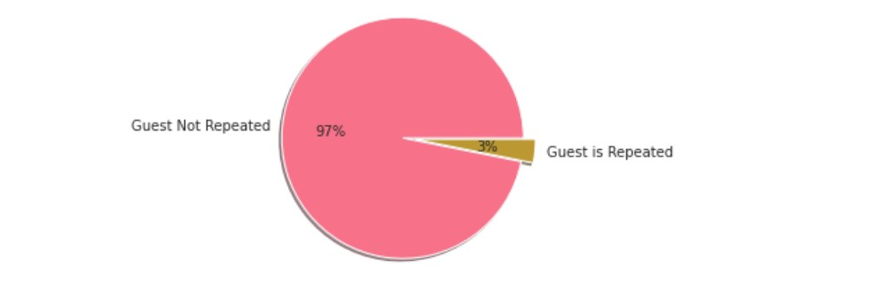
This pie chart shows that only 3% guest is repeated hotel .it means only 3755 guest out of 115455 is repeated

Slide 13
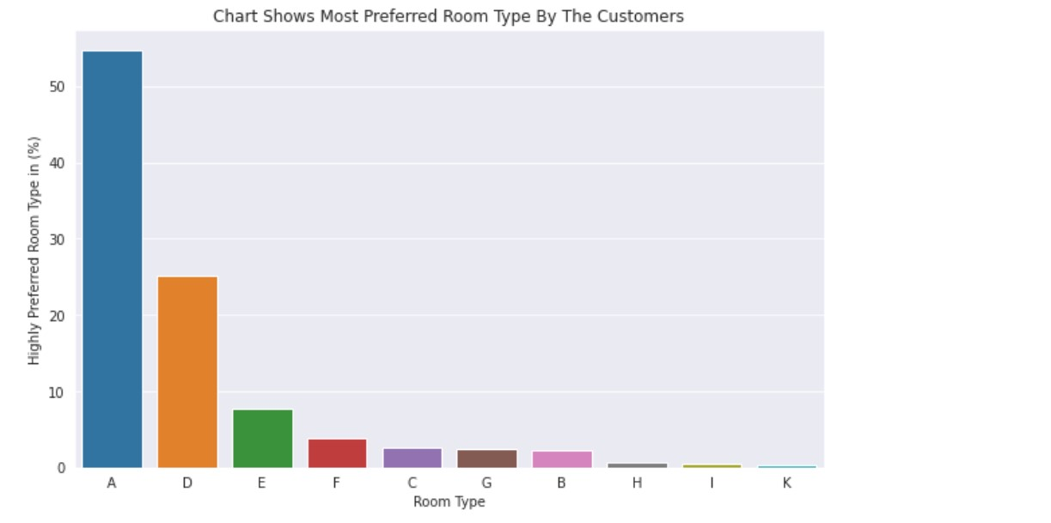
This bar chart shows most preferred room type by the customers.

Slide 14
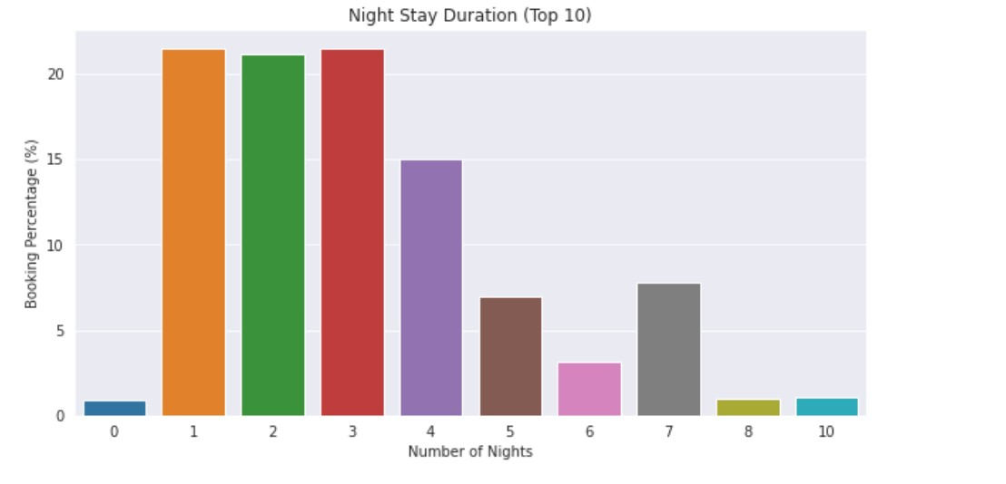
In this graph we can see that customers hardly stay more than 3-4 nights

Slide 15
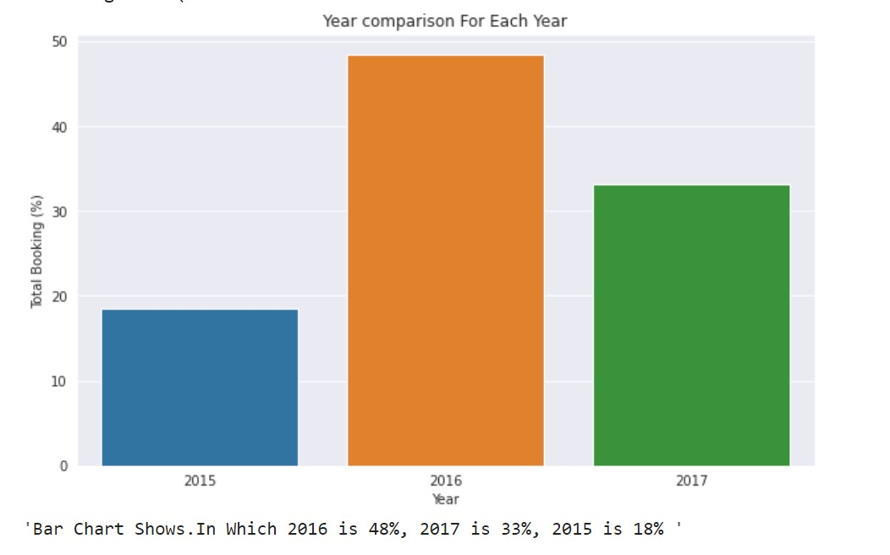
2016 have been great year for hotel booking following by 2015

Slide 16
Challenges faced during project
Reading the dataset and understanding the meaning of some columns.
Handling NaN values ,null values and duplicates.
Designing multiple visualizations to summarize the information in the dataset and successfully communicate the results and trends to the reader.

Slide 17
Conclusion / Analysis summary
Data was given of the Hotel Booking Analysis and the data was about the types of hotels, Type of customers, Types of Country from where the guest has been arrived, the Data consist of 3years of booking.
We need to understand that why only 3% guest has repeated, what problems they facing during stay.
Booking in 2017 is less than 2016.
Booking cancelation rate is very high.
If we see monthly booking trend we can divide it in quarter i.e. November to February booking rate seems constant similar in month march to June and then July to august has high bookings.
City Hotel has more number of bookings as compared to Resort Hotel.

Slide 18
Thank you

